Slide 1
<CO2 Emissions in the context of Economic Growth>
<Aydin Jalilov>

Slide 2
Dataset(s)
Primary dataset used in this project is
World Development Indicators Dataset from World Bank
Additional Datasets:
Oil prices from 1986 todate obtained from https://fred.stlouisfed.org/series/DCOILWTICO
Average Retail price of Electricity obtained from https://www.eia.gov/electricity/

Slide 3
Motivation
Emerging Global concern about the Climate change due to greenhouse gases, particularly CO2 were challenged by some countries claiming that the environmental degradation directly related to Economy Growth and is inevitable.
This work analyses Global CO2 emissions within the context of Economic Growth
The analysis conducted on different group of countries based on their GDP per capita to find out whether this claim holds true.

Slide 4
Research Question(s)
How are US CO2 emission per capita volumes compare against those in other developed nations, particularly EU nations.
How are GDP and CO2 emissions per capita correlated in Least developed nations.
How are total amount of the CO2 in kt and total GDP (inflation included) correlated – US only
What are the main sources of CO2 emissions and how are they correlated.
Why are there fluctuations in CO2 emission over time? Insights
Statistical Tests – Ttest, Anova, Kruskal

Slide 5
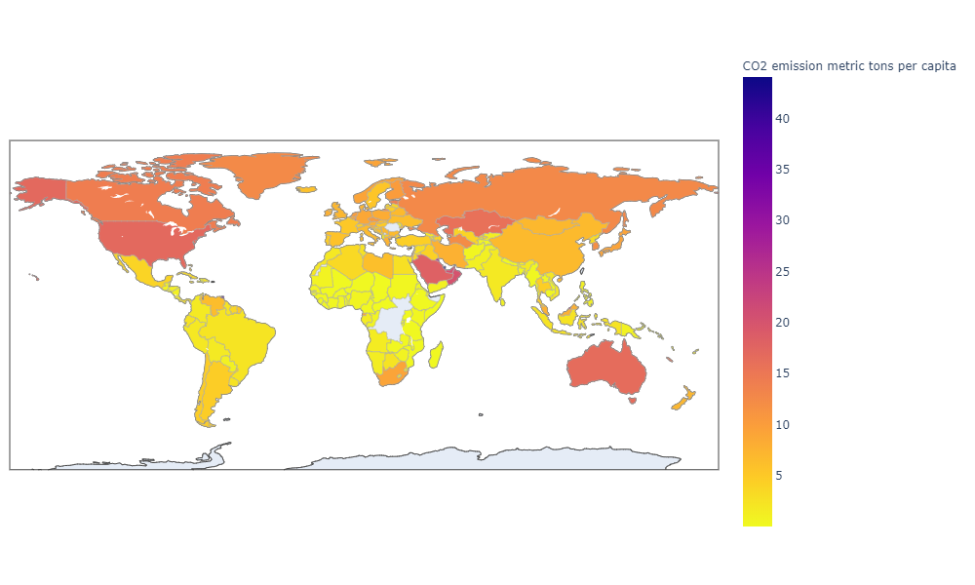
Findings
USA is an outlier and Is exceeded
Only by Middle East nations and
Trinidad and Tobacco in S. America

Slide 6
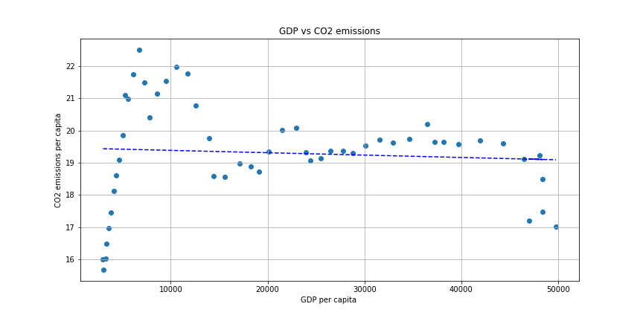
Findings
There is string correlation between
GDP and CO2 values per capita in
1960’s but after that GDP values per
Capita are independent from CO2
volumes. There may be many reasons to
this, e.g. diversification of economy after
Oil crisis in 1973, advent of new more efficient technology, nuclear energy consumption, alternative energy, etc.

Slide 7
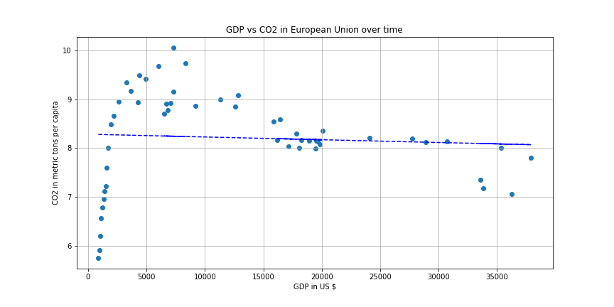
Findings
EU has similar pattern in GDP vs CO2 per
Capita values as we seen in US.

Slide 8
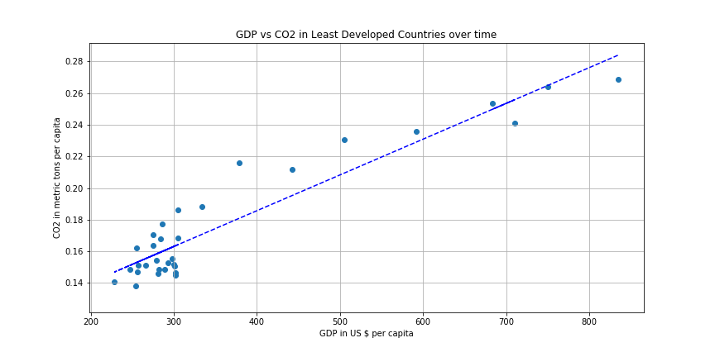

Findings
2. Correlation between GDP per capita and CO2
per capita values is very strong.
It is antithetical to what we have observed in
developed Nations meaning their economy is
more dependent on technology that produces
CO2.

Slide 9
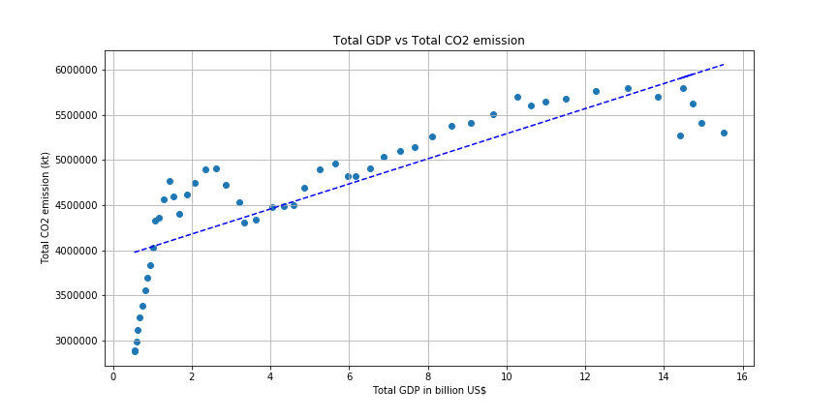
Findings
3. Remarkable Finding. Total GDP
and total CO2 in US are linearly
correlated. This unfortunately this are the
GDP values with inflation included which
may distort the results of the analysis.
Also the population might be a big
factor. This finding needs more analysis.

Slide 10
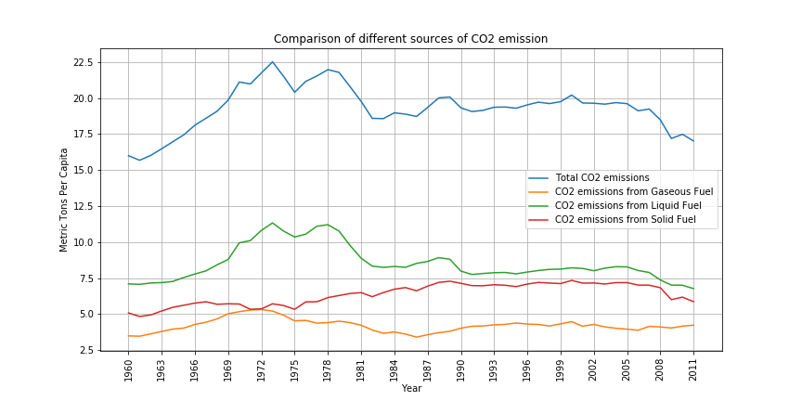
Findings
4. There are 3 main sources of CO2 emission.
CO2 emissions from Gaseous fuel
CO2 emission from Liquid Fuel
CO2 emission from Solid Fuel
Although for the most part Total CO2 emission per capita and CO2 emissions from Liquid fuel behave similarly and strongly correlated, after the Recession behavior of the total CO2 emissions and the CO2 emissions from Solid Fuel is very similar. Does this mean that main liquid fuel users switching to alternative energy?

Slide 11
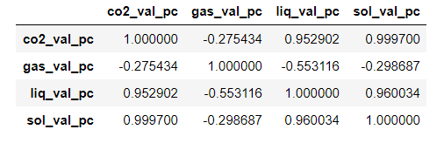
Findings
After 2008 correlation between different sources
Of CO2 emissions reveal important facts.
Correlation between the Solid Fuel CO2 emission values and Liquid Fuel CO2 emission values is very strong and positive. This means that both are not alternative to each other but rather the industries that use Liquid Fuel also use Solid Fuel or the industries that use either of these fuel types are dependent on each other.
Correlation between the Gaseous Fuel and other types of fuel is always negative meaning that the Gaseous guel is a true alternative. It also means that the increase in usage of Gaseous fuel decrease the amount of CO2 by through lesser usage of Liquid and Solid Fuels
CO2 per capita values have very strong relation with Solid Fuel.

Slide 12
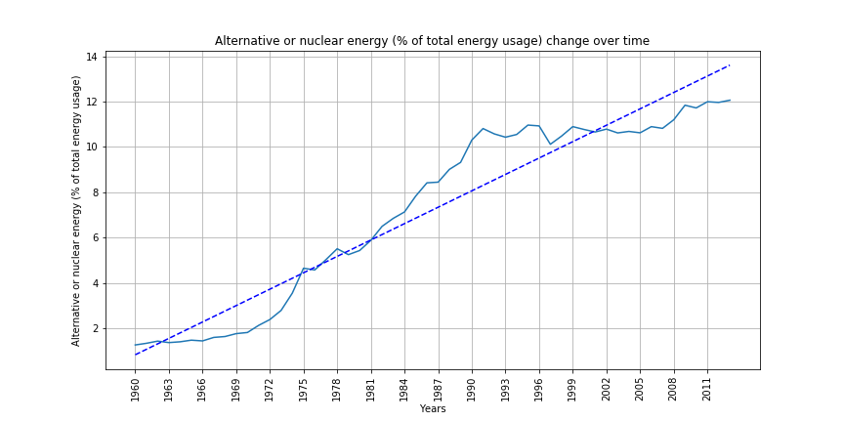
Findings
5. Irregularities in CO2 emission values per capita
May be related to the emerging technology, as well
As the usage of nuclear and alternative energy.
Also, more efficient usage of the liquid fuel may
Result in lesser CO2 emissions. If there is new
Technology introduced then the electricity retail prices also should increase to cover the expenses.

Slide 13
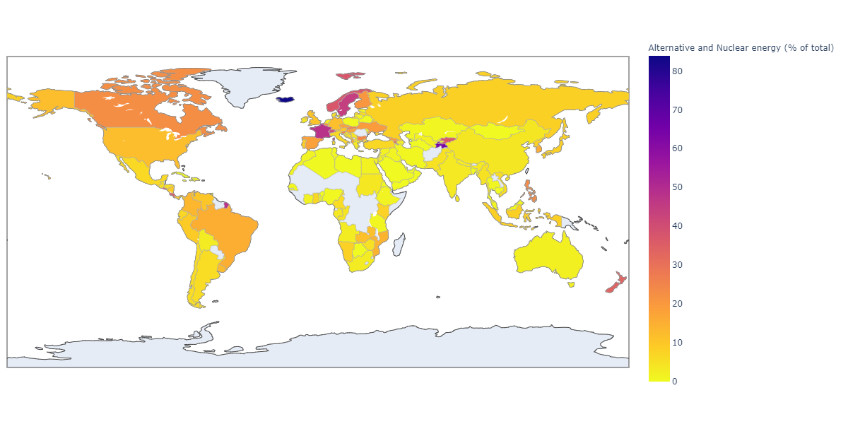
Findings
Alternative and nuclear energy
Usage in US in 2011 was 12%
As an example, Canada was at
23%, France at 47%, Iceland at
84%.

Slide 14
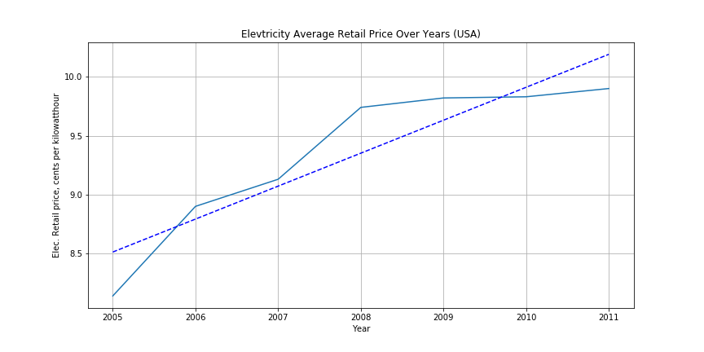
Findings
Electricity retail prices increase over
time..

Slide 15
Findings
6. Statistical Tests. For this part the countries are divided into groups based on their GDP per capita.
lowGDP = dataCountries[dataCountries["Value"].values < 2500]
mediumGDP = dataCountries[(dataCountries["Value"].values >= 2500) & (dataCountries["Value"].values < 12000)]
highGDP = dataCountries[dataCountries["Value"].values >= 12000]

Slide 16
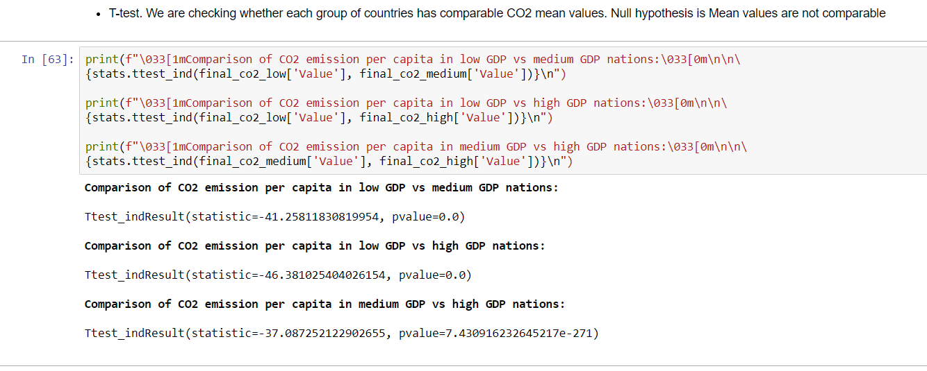
Statistical Tests Results

Slide 17
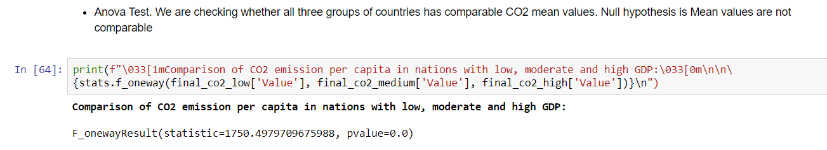
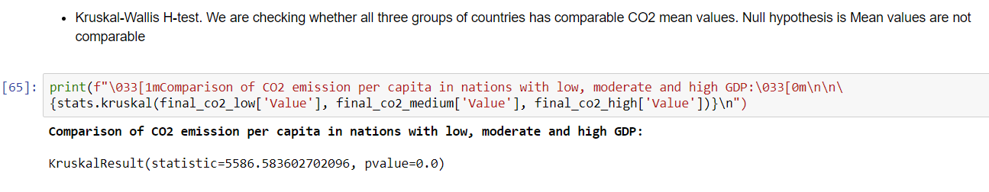
Statistical Tests Results

Slide 18
Conclusion
As the production increases the amount of CO2 emission increases as well. CO2 emission is directly related to the energy production and energy production uses CO2 producing technology.
Although CO2 emission increase every year almost linearly since 1960 the GDP value of CO2 emission reduce thanks to implementation of new technology, more efficient fuel burning mechanisms, alternative and nuclear energy.
Gaseous Fuel is a true alternative to Liquid and Solid Fuel types to reduce the CO2 amount.
CO2 per capita may be misleading since the primary goal is to harness the total CO2 but the total CO2 volumes keep increasing.
Least developed nations do not use advanced technology and cheap but less efficient usage of the Fuel result in increased CO2 per capita.

Slide 19
Acknowledgements

Slide 20
References

